Slide 1
Introduction to computers and Computer Hardware
Presented by
Syed Shakil Mahmud
Lecturer
Department of Computer Science and Engineering
Bangladesh Army International University of Science and Technology

Slide 2
Computer Ports
Ports are nothing but it is connections between external and internal input/output devices such as keyboards, mice, mouse, Disk Drive, and many more with motherboards using cables.
It allows to communicate between external devices or peripherals with a laptop or computer.

Slide 3
Computer Ports
There are different characteristics of computer ports:
Computer ports are the slots in the motherboard in which cables of the external devices are plugged in for communication.
It allow unidirectional and bi-directional communication between the computer and connected devices.
Some ports, like USB and Thunderbolt, can transmit both data and power
Many ports allow "hot-plugging," meaning devices can be connected or disconnected while the computer is on without needing to restart the device.

Slide 4

Types of Ports
1. Serial Port(COM Port)
A serial port is also called a communication port and they are used for connection of external devices like a modem, mouse, or keyboard (basically in older PCs). Serial cables are cheaper to make in comparison to parallel cables and they are easier to shield from interference. The rate of transmission of data in the serial port is 115 KB/sec.

Slide 5

Types of Ports
2. Parallel Port (LPT Ports)
Parallel ports are generally used for connecting scanners and printers. It can send several bits at the same time as it uses parallel communication. Its data transfer speed is much higher in comparison with the serial port. It is a 25-pin model.

Slide 6

Types of Ports
3. USB (Universal Serial Bus)
This can connect all kinds of external USB devices, like external hard disk, printer, scanner, mouse, keyboard, etc. There are a minimum of two USB Ports provided in most of the computer systems. It is a kind of new type serial connection Port that is much faster than the old serial Ports. The data transfer rate in this is 12 megabits per second.It also provides plug-and-play communication.

Slide 7
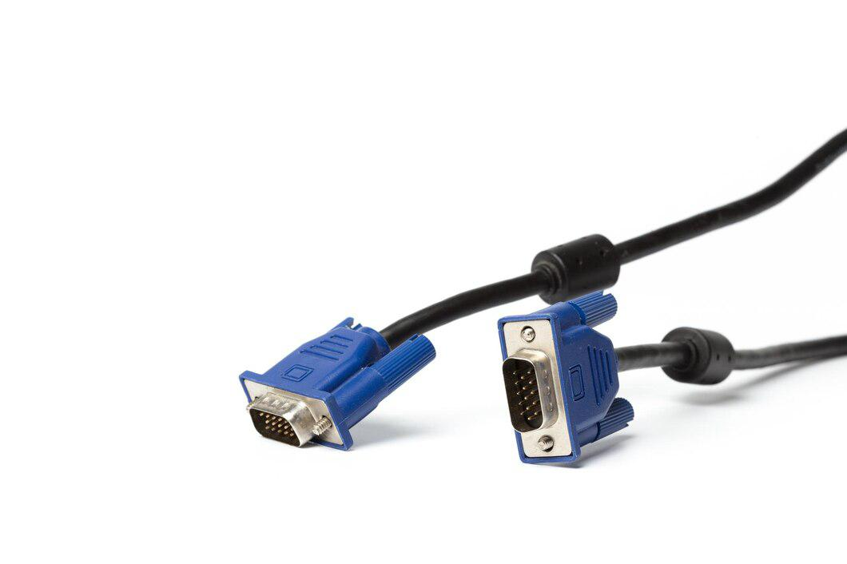
Types of Ports
4. VGA Port
VGA ports also known as Video Graphic Array connectors are those which connect the monitor to a computer’s video card. VGA port has 15 holes and it is similar to the serial port connector. But VGA Ports have holes in it and the serial port connector has pins in it.

Slide 8

Types of Ports
5. Ethernet Port
Ethernet Port helps to connect to a network and high-speed Internet(provided by LAN or other sources). It connects the network cable to a computer and resides in an Ethernet card. It provides a data travel speed of 10 Mb to 1000 Mb(megabits) per second.

